Slide 1
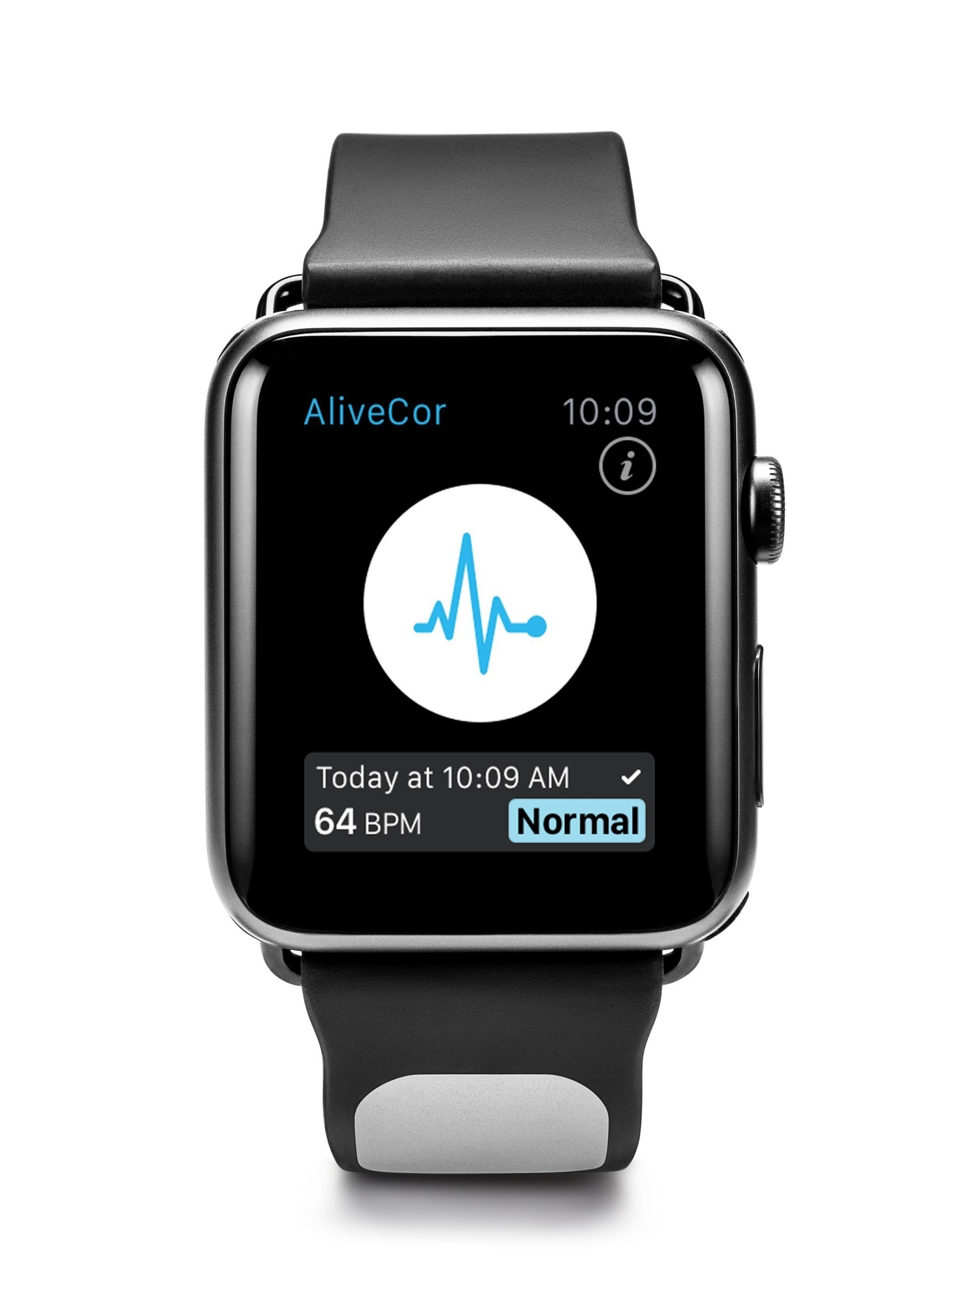
Team 4:
Human Activity Recognition Using Physiological data from Wearables
Team: Kush Gulati, Annie Hirsch, Noah Lanier, Nathan Warren
Project Manager: Brinnae Bent
Project Lead: Dr. Jessilyn Dunn
Notes:
https://www.medgadget.com/2016/03/kardia-ecg-band-for-apple-watch-unveiled.html
Presentation is focused on scope of project and why we are doing what we are doing

Slide 2
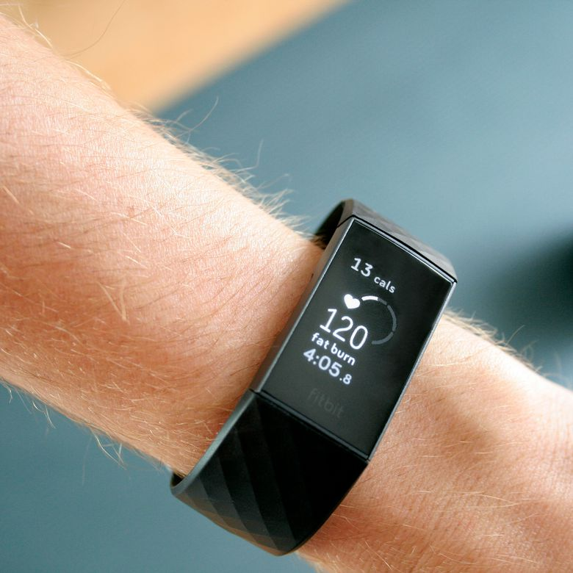
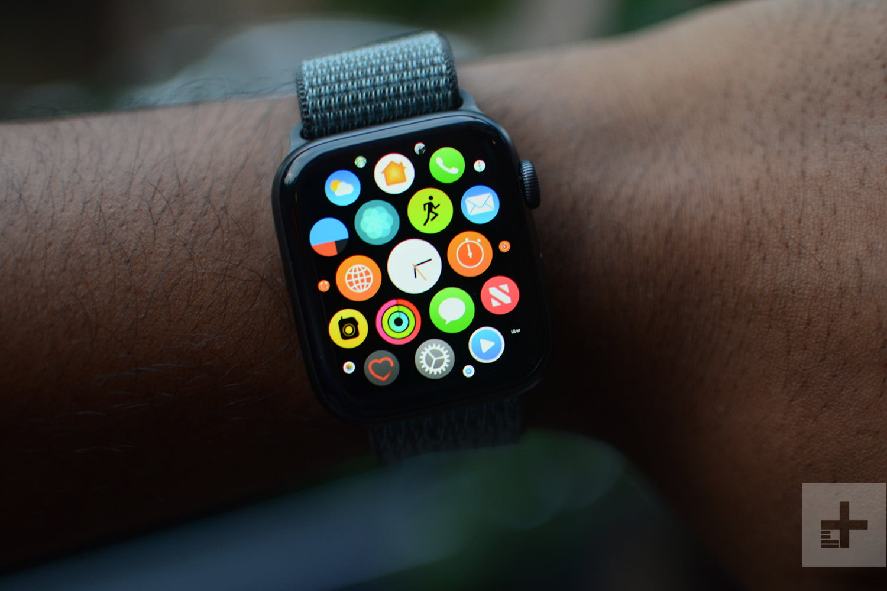
Notes:
21% of americans have a smartwatch

Slide 3
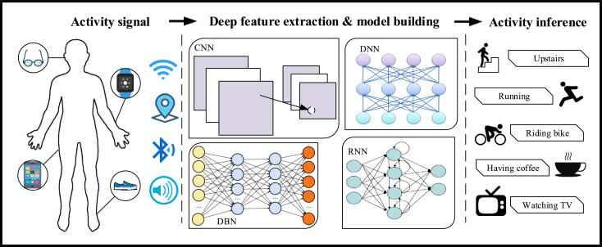
What is Human Activity Recognition?
Human activity recognition (HAR) is the automatic recognition of physical activities through wearable devices that monitor mechanical and physiological states over time.

Slide 4
Presentation Overview
Introduction to wearables in healthcare
Overview of the Activity Recognition Chain
Why deep learning?
Objectives
Next steps

Slide 5






The Har Equation
60.5 million people in US
= gain new insights about human activity for more personalized, effective care
using 117 million wearable devices
+
mHealth technology improvements

Slide 6
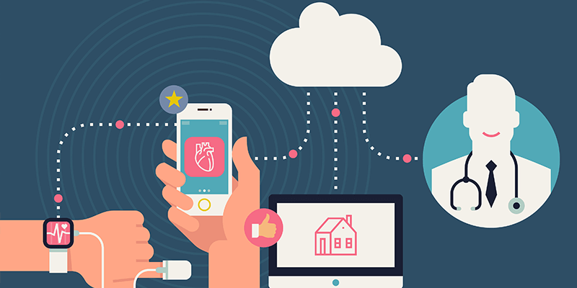
Current Applications
Wearables have shown promise in:
Making long-term, continuous management of patients easier
Providing care in rural areas without much access to in-person care
Giving deeper insight into population-level and individual patient behavior & health ⇾ precision medicine
Notes:
Applications:
Managing long-term care: neurodegenerative/elderly patients, chronic cardiac diseases
Detecting arrythmias
Tracking migraine days/mental health status

Slide 7
Activity recognition chain
Data Acquisition
Feature Extraction
Model Validation
Preprocessing
Model Selection
Performance Evaluation
Notes:
To develop end-to-end applications of HAR in healthcare and beyond that annie discussed, the general process is classified as the Activitiy Recognition Chain. The ARC generally follows the proceeding steps (Bulling et al., 2014). After data acquisition, the sensor data is preprocessed. The kind of preprocessing technique performed is dependent on the type of sensor data. Whether or not a deep learning model is selected will determine if feature engineering is required as a next step. Deep learning methods automatically discover representations of outputs as functions of inputs, or features. If a traditional machine learning method (non-deep learning) is selected, then one will have to engineer features of the data. The model then takes instances of the hand-created features as inputs and attempts to find relationships between them and behavioral classifications. The end goal for both models is the same: To correctly classify a high percentage of unseen data. Various assessments, such as confusion matrices, are used to estimate model performance.

Slide 8
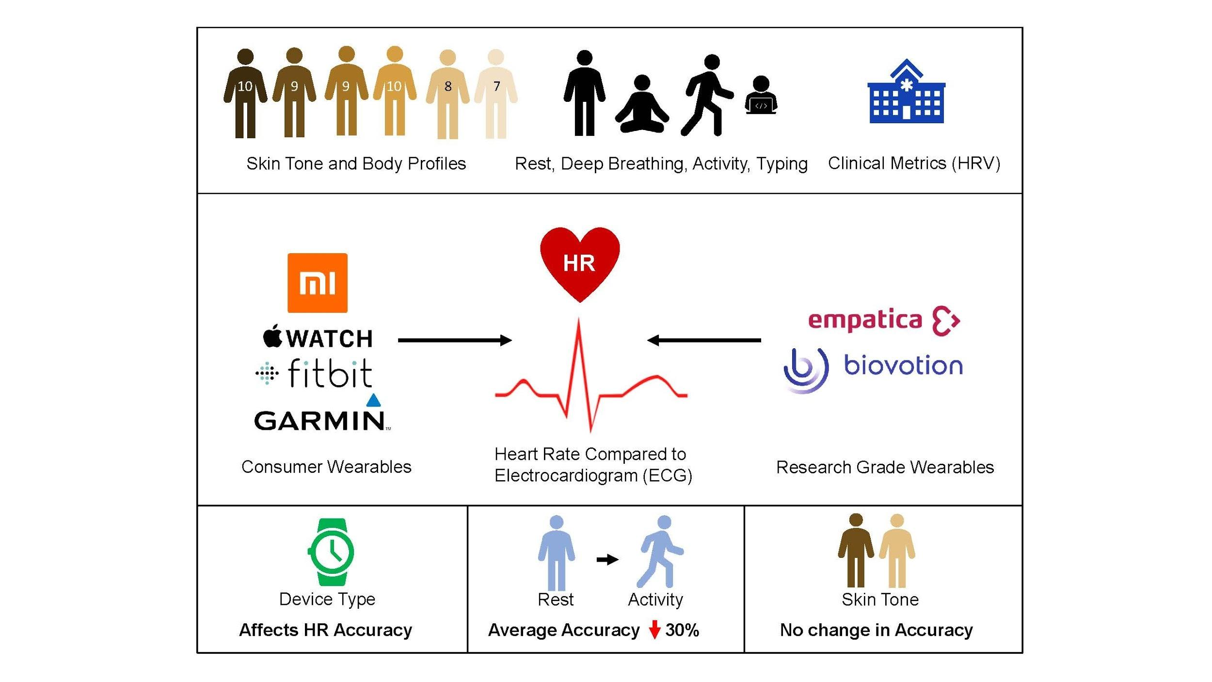
Data Collection
From: Investigating sources of inaccuracy in wearable optical heart
rate sensors
(Bent et. al, 2020)
Notes:
Our data was collected from research on [‘Insert Title’]. 56 participants completed rest, deep breathing, walking, and typing and we are using the data collected from the empatica research grade variable.
~ 100,000 seconds total
~6 million BVP measurements
~400,000 EDA measurements
~400,000 Skin Temperature Measurements
Participants, not patients
Did not find statistically significant difference in HR or HRV accuracy across skin tones
Wearable devices have higher error during activity than at rest
Directionality of this error is dependent on activity type
Overall over-reporting of HR during low-intensity physical activity
Research grade wearable can visualize PPG waveforms and calculate HRV, but HR measurements tended to be less accurate than consumer-grade wearables

Slide 9
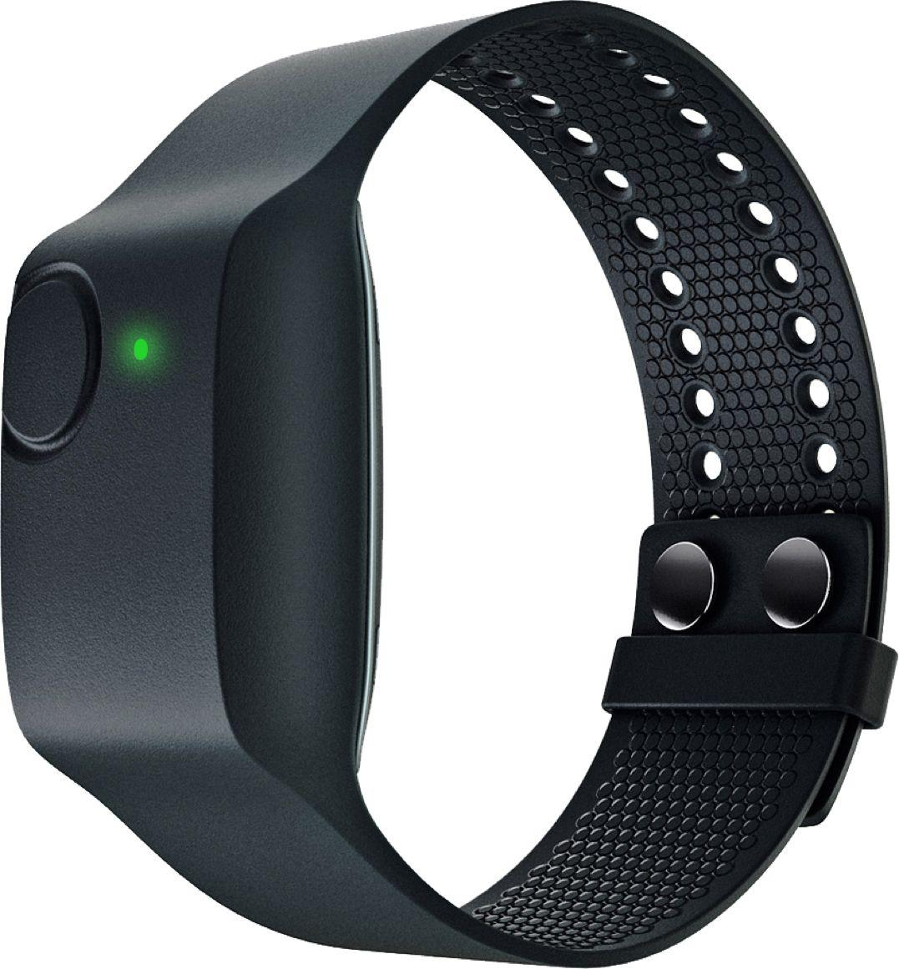
Sensors
Blood Volume Pulse/HR (physiological)
Electrodermal Activity (physiological)
Skin Temperature (physiological)
3-axis Accelerometer (mechanical)
Notes:
Can briefly explain each of these sensors
Current uses of Empatica E4:
Preventing migraine attacks (blood volume, HR, skin temp)
Emotion recognition (HR, etc.)
Could be used in combination with lightweight CNNs (like mini-Xception), which could work on a phone to enhance this classification
Biochemical sensors as well
Stress detection (skin temp, etc.)
Dance tracking
Composite activities (e.g. tennis, which is comprised of running, walking, swinging)
Aiding in new frameworks that help identify household activities like cooking, cleaning, eating
Overlapping/ concurrent activities (walking and eating)
Predicting future activities

Slide 10
Data Acquisition
We are using the Empatica E4, a research-grade wearable, over consumer-grade wearables because of the:
High sampling rate: Empatica sensors read up to 64x per second, compared to Apple Watch’s 12x per minute.
Variety of sensors: the electrodermal activity, skin temperature, and other physiological sensors are not common in consumer-grade wearables.
Access to raw signal data: consumer-grade wearables preprocess (and aggregate) the data within the hardware to save memory and hide proprietary algorithms.
Notes:
not just to save memory by also because they don't want you to reverse engineer their proprietary algorithms (you can do this if you have raw data + processed data, I have even done this before!

Slide 11
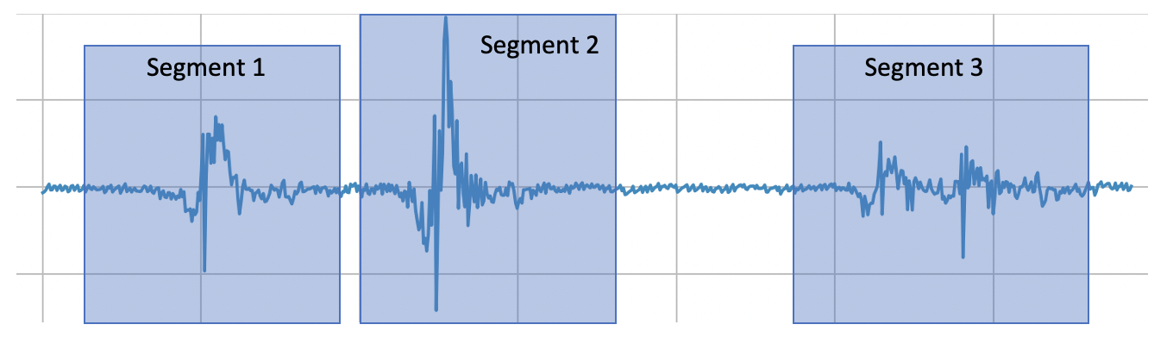
Preprocessing - Activity Segmentation
Time series data requires us to segment the data to capture specific windows when activity is occuring.
Popular methods:
Energy-based
Sliding-window
Notes:
https://pubmed.ncbi.nlm.nih.gov/30730297/
Takeaway: Different segmentation techniques have different advantages in detecting activities.
Computational power needed + data storage vs. capturing all activities possible

Slide 12
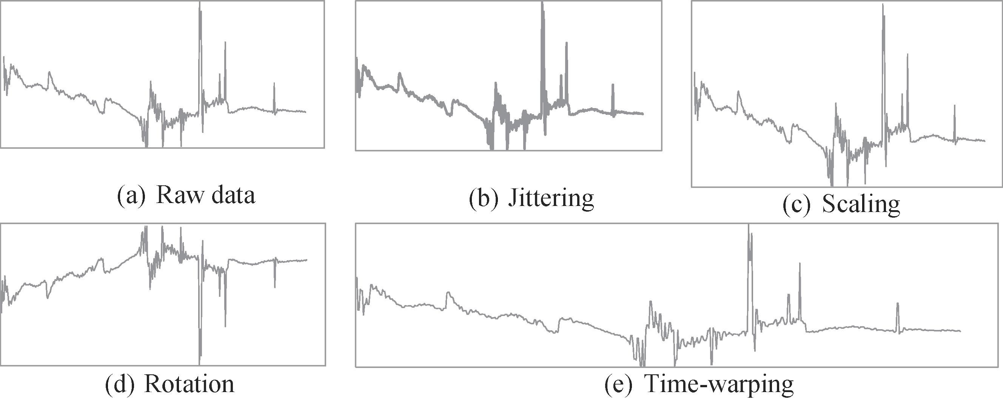
Preprocessing - Data Augmentation
Data augmentation is used to prevent overfitting by creating deformations in the data without changing the semantics of the raw data
Data augmentation allows us to build a more robust and generalizable model
Notes:
https://pubmed.ncbi.nlm.nih.gov/30730297/
Factors that can introduce variability without altering the labels of the time-series data are random noise, sensor placements, and temporal characteristics of activities
Data augmentation techniques are based on variation in observations that occur when collecting data

Slide 13

Feature Extraction
Notes:
What are features?
Experts.
Activity complex.
Deep learning.

Slide 14
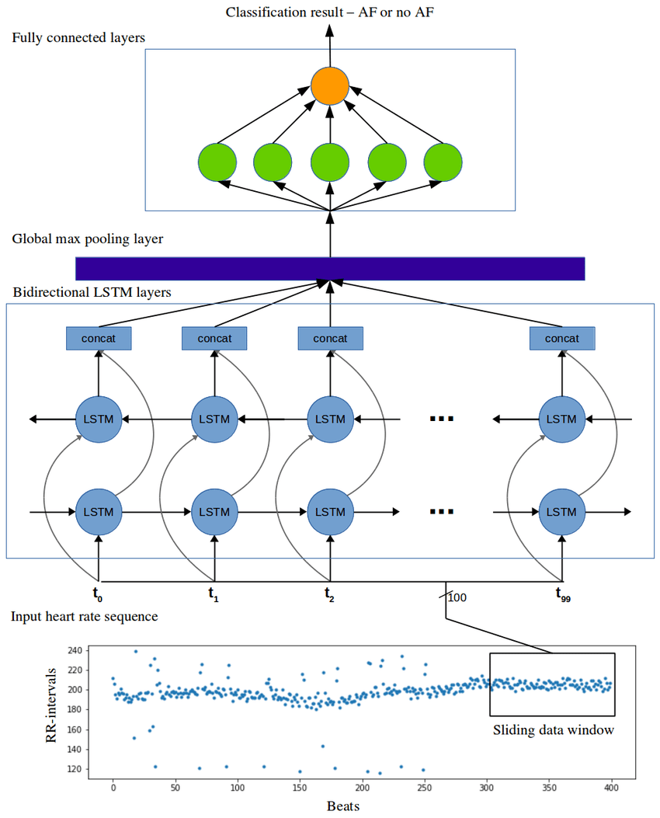

Deep Learning Model selection

Slide 15
Deep Learning Model selection

Slide 16
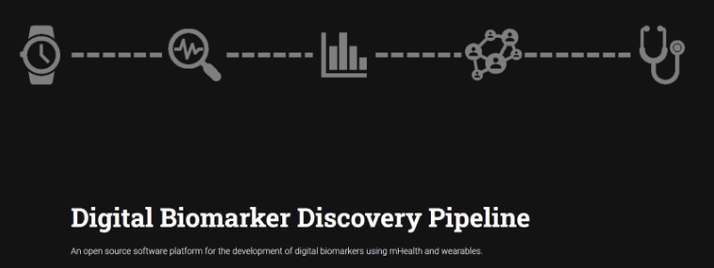
Objective
The goal of the Human Activity Recognition Team is to create a deep learning predictive model that:
Takes in multimodal data from mechanical sensors and physiological sensors.
Classifies human activity (rest, deep breathing, walking, typing) at high accuracy and precision, while being generalizable and adaptable to other HAR datasets.
Notes:
Having 3 PHYSIOLOGICAL SENSORS MAKE OUR MODEL UNIQUE
We aspire to make our work open source, as a part of an overarching digital biomarker discover pipeline, as part of the Big Ideas lab at Duke

Slide 17
Next Steps
Aggregate data
Exploratory Data Analysis
Address class imbalance
Begin preprocessing
Notes:
Talk about stacking models here?

Slide 18
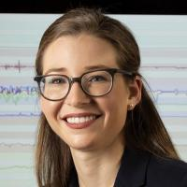


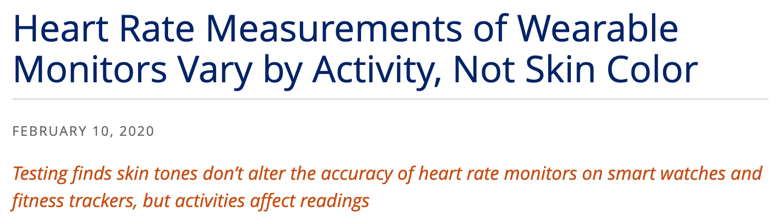
Notes:
Added animation on click in this order
Dr. Dunn
Heart rate measurements
COVIDENTIFY

